Slide 1
Line Rejection Data
-Sarah Brown-

Slide 2
What is affecting Line Rejection?

Slide 3
Does the average temperature affect the Line Rejection Rate?

Slide 4
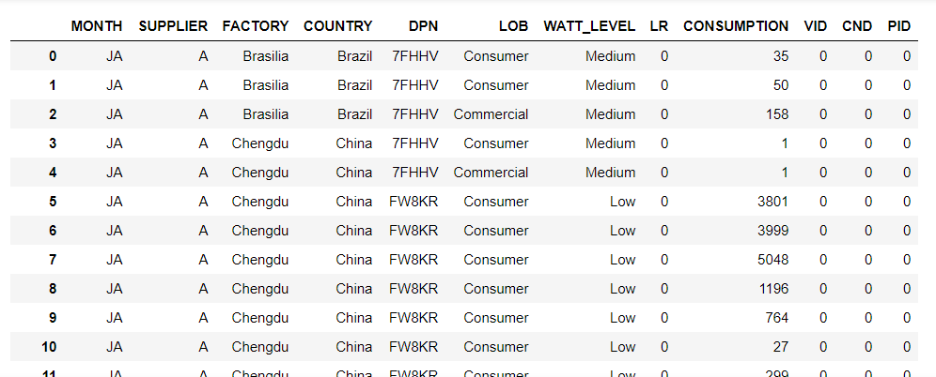
Cleaning data.

Slide 5
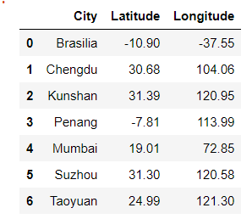
openweatherAPI

Slide 6
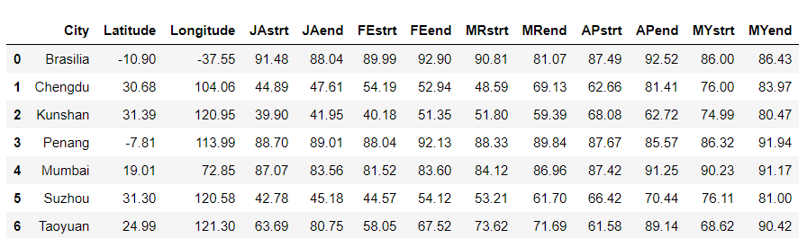
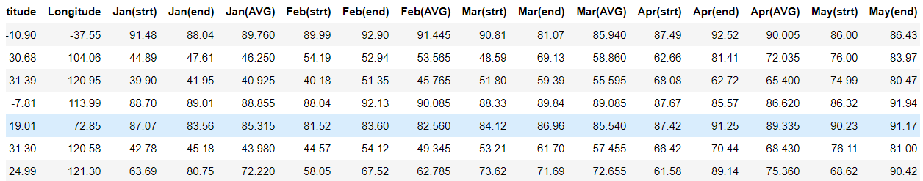
Dark Sky API before and after.

Slide 7
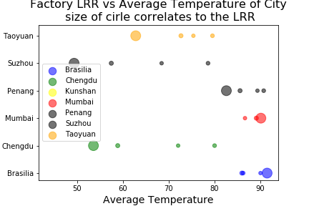

Slide 8
Factory and Line Rejection Rate

Slide 9
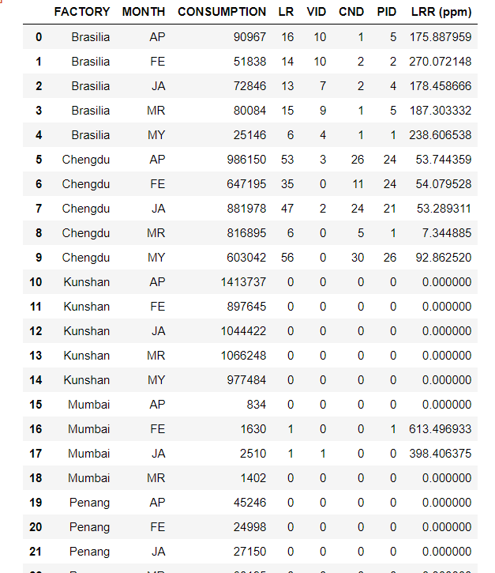
Data Cleaning Factory and LRR

Slide 10
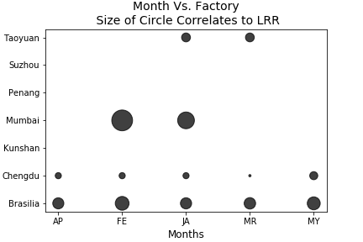

Slide 11

Supplier Vs Line Rejection Rate

Slide 12
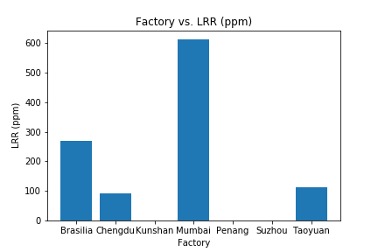
Factory Vs LRR

Slide 13
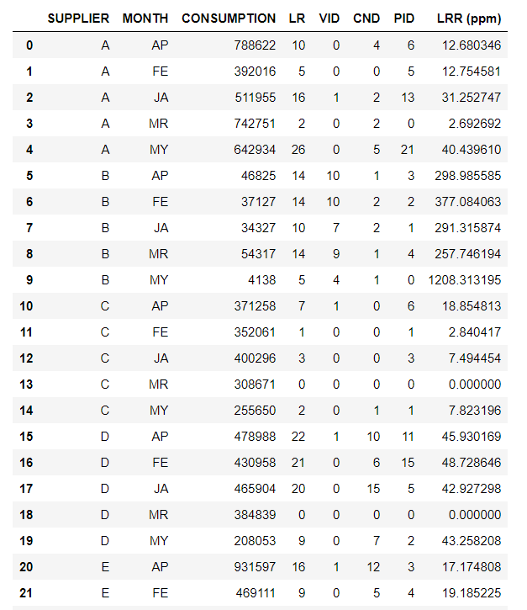
Data Cleaning for LRR vs Supplier

Slide 14
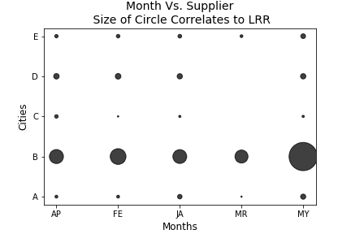

Slide 15
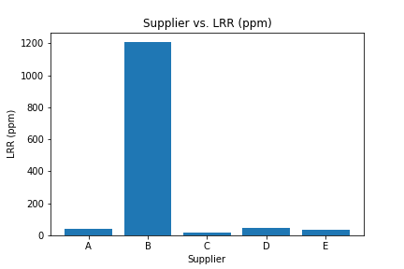
Supplier vs LRR

Slide 16
Resources for API
https://openweathermap.org/
https://api.darksky.net/forecast/

